Slide 1
Machine Learning for Stock Index Prediction
Shi Kaiwen
Directed Reading Program Presentation
Mentor: Hyun Jong Kim
Fall 2023

Slide 2
Agenda
Initiative
Data Processing
Training
Result
Next Step

Slide 3
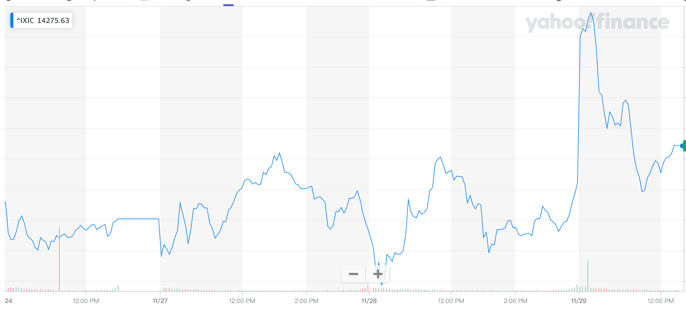
Stock index prediction can be tricky…
Nasdaq index drops today; how will it go tomorrow?
Notes:
Explain what stock index is a little bit: A market index is a hypothetical portfolio of investment holdings that represents a segment of the financial market. The calculation of the index value comes from the prices of the underlying holdings.

Slide 4
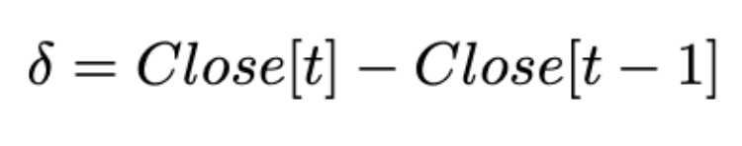
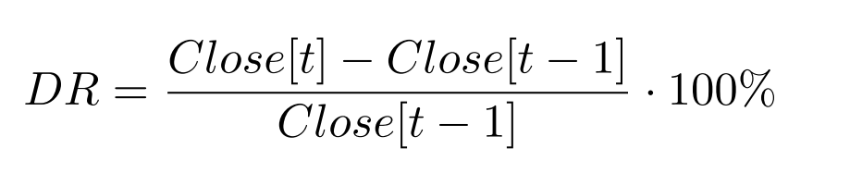
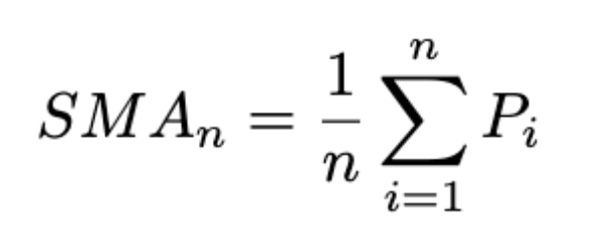
Maybe we can generate some “features”…
“Trends”: 1 if δ > 0; 0 else
Daily Returns (DR)
Simple Moving Averages (SMA(n)):
…
Notes:
Features are input we can feed to the model; the model can produce output

Slide 5
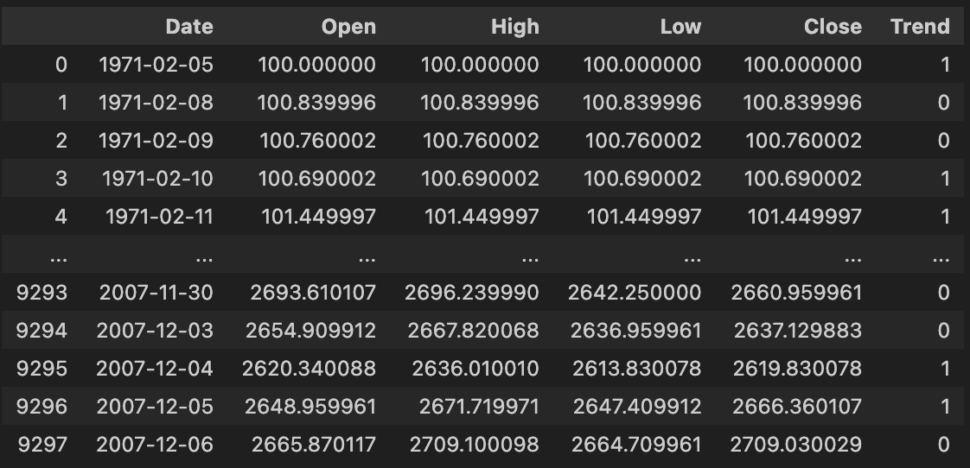
Start Training!
Approach 1: Bernoulli Naive Bayes
Approach 2: Single - Featured LSTM
Approach 3: Multi - Featured LSTM

Slide 6

Bernoulli did a decent job…
Some Simple Probabilistic thing…
Notes:
Explain what BNB suppose to do, and how to “just probabilistic thing ”

Slide 7
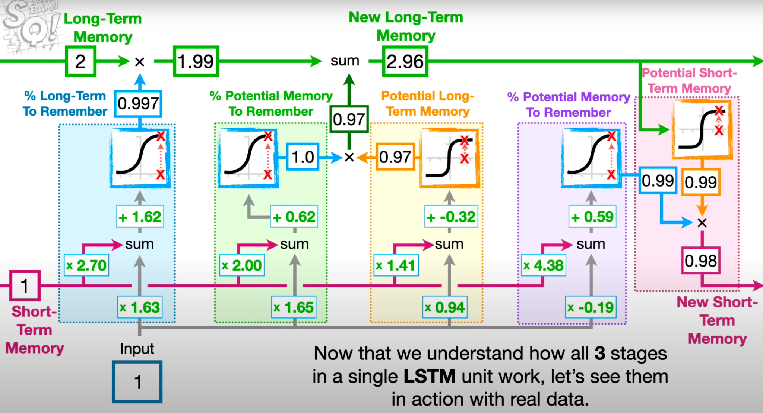
Long Short Term Memories (LSTM)..
Good for time-series datasets (e.g., stock prices)
Use 2 things to predict:
Long-Term Memories
Short-Term Memories
Notes:
Explain what is “long term”, what “short term” is, and why they are good at predict things
Long term: ability to retain information over extended sequences, effectively remembering inputs from many steps back in the sequence.
Short Term: network's capability to process and remember recent information, which is critical for understanding the immediate context in a sequence

Slide 8
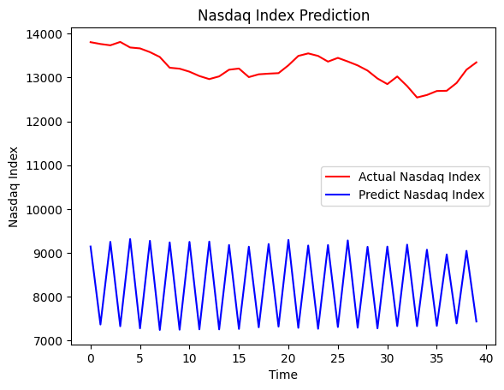
What happened if we just try to predict one month…
Notes:
Explain what is “overfit” OR don’t use the word.

Slide 9
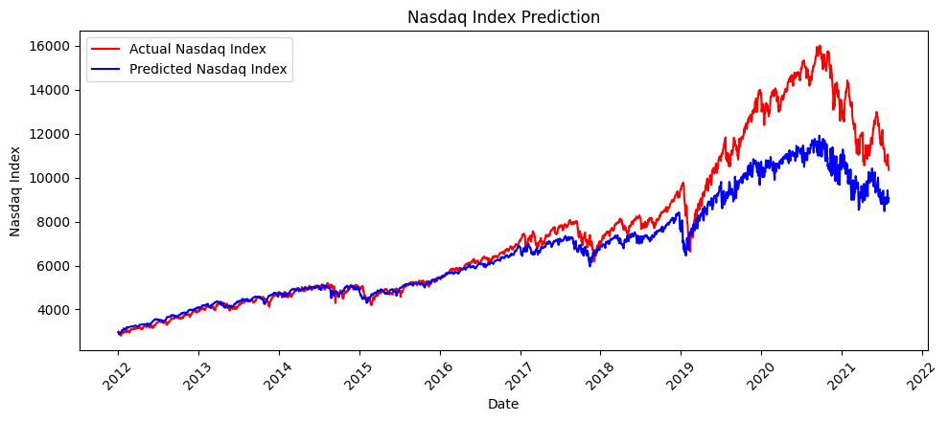
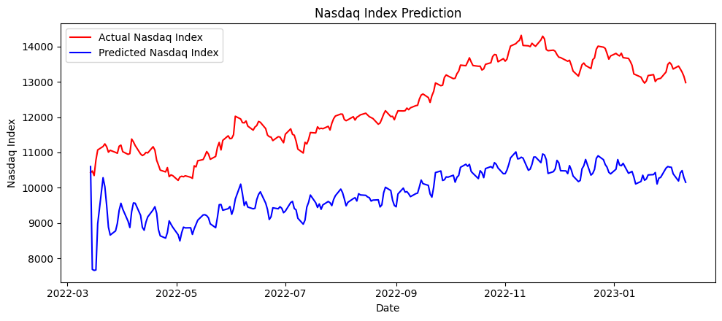
But general, LSTM seem to be good
10 year & 1 year prediction
Notes:
Mention specific years these data - recreate the x axis what points of time things are happening

Slide 10
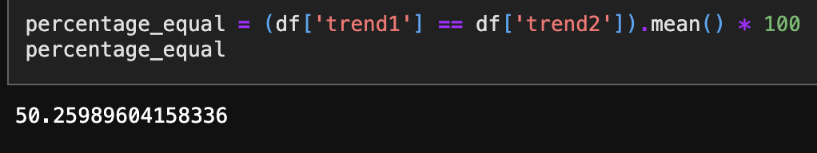
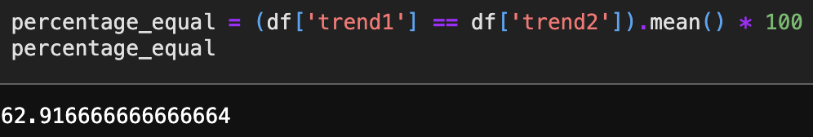
Is the graph the truth?
10 years:
1 year:

Slide 11
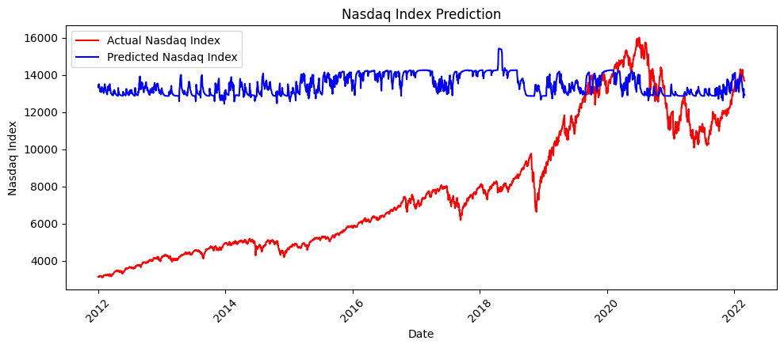
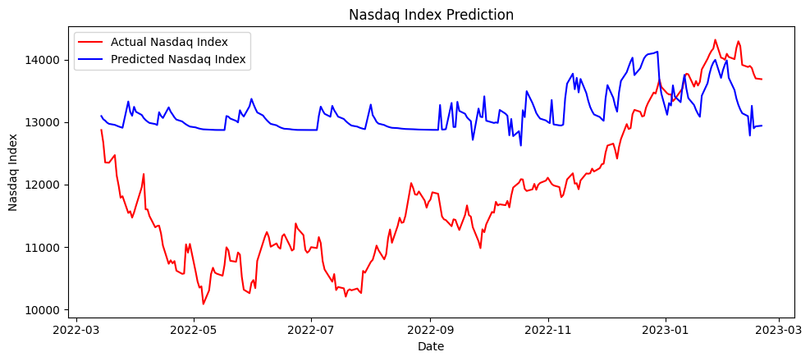
What if we add more features…

Slide 12
Conclusion so far:
Lot of things to learn when we try to “trade rationally & wisely”
Trend Similarity ≠ Prediction Accuracy!
Long way to go to make more accurate predictions

Slide 13
Next step…
Figure out why multi-feature does not work
Seek ways to improve prediction accuracies
Use it for actual trading!

Slide 14
Questions?

